Slide 1
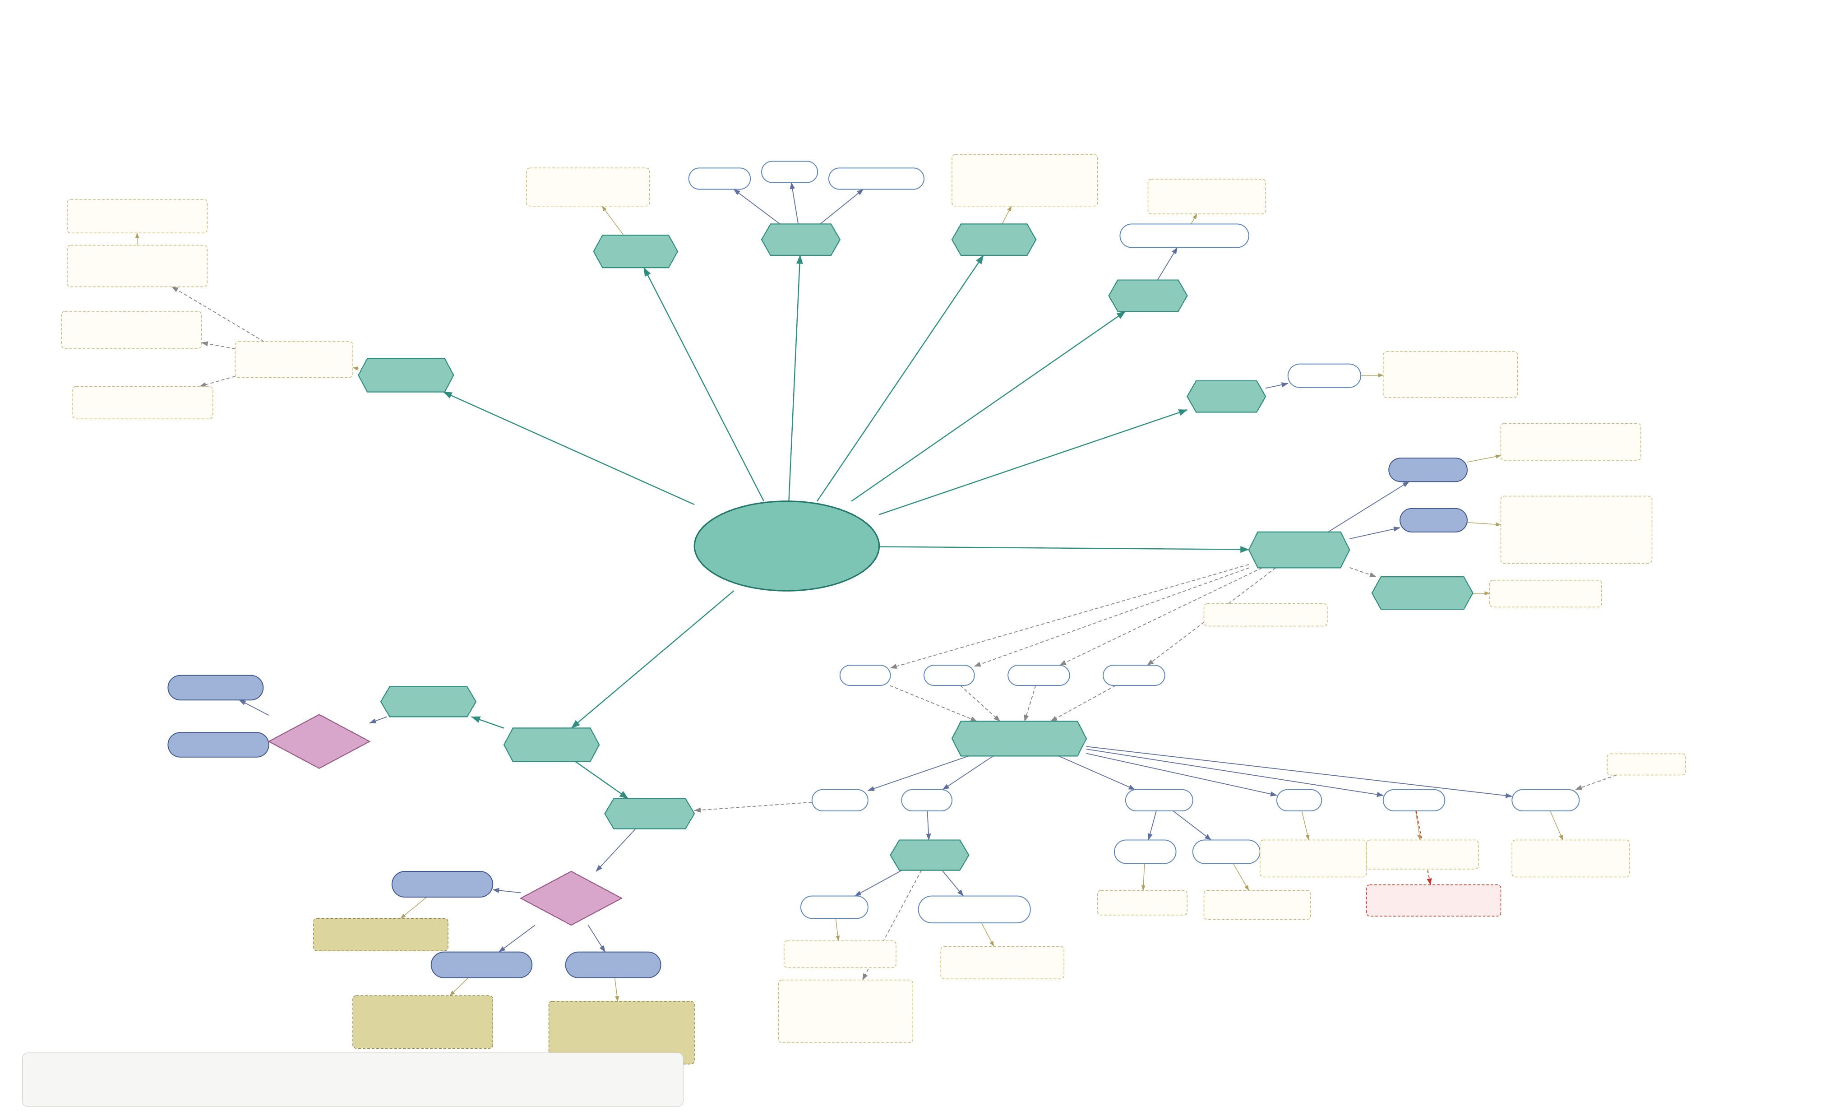
B/B · MCAT BIOLOGY
Melatonin → Circadian Rhythms
Secretin
Gastrin
Cholecystokinin
Erythropoietin (EPO) → bone marrow makes more RBCs in response to low O₂
Regulates Salt & Water balance in blood
Also from Hypothalamus → ↓ Growth Hormone (GH)
Somatostatin (δ-cells) inhibits Glucagon & Insulin secretion
Pineal Gland
GI Tract
Kidneys
Atrial Natriuretic Peptide
δ-cells
Heart
Insulin (β-cells) glucose HIGH → ↑ fat & protein synthesis
β-cells
Hormone-producing cells in Islets of Langerhans
T-cell development & differentiation in the immune system
α-cells
Pancreas
Thymosin
Glucagon (α-cells) glucose LOW
Thymus
Uterine contractions; positive feedback loop
Oxytocin
makes
ADH
↑ permeability of renal collecting ducts → ↑ blood volume & BP (water reabsorption)
endocrine system
Hypothalamus *
makes
stored in
Posterior Pituitary
stores & releases Oxytocin + ADH
*via Hypophyseal Portal System
Epinephrine
CRF
TRH
GnRH
GHRH
Adrenal Medulla
Norepinephrine
Catecholamines
Adrenal Gland
Anterior Pituitary Tropic Hormones
Pain Signals
Adrenal Cortex
→ adrenal cortex
ACTH
TSH
FSH & LH
GH
Prolactin
Endorphins
Thyroid
Testes
Ovaries
Stimulates bone & muscle growth
Stimulates mammaries to produce milk
↓ pain sensation; promotes euphoria
Cortical Sex Hormones
Corticosteroids
C-cells
follicular
Testosterone
Estrogen & Progesterone
Inhibited by Dopamine, Estrogen & Progesterone
Calcitonin
T3 & T4 (Triiodothyronine / Thyroxine)
Androgens (♂) & Estrogens (♀)
Parathyroid
Mineralocorticoids
Glucocorticoids
↓ plasma Ca²⁺ levels
Affects metabolism & cellular respiration
Salt & water homeostasis via Renin–Angiotensin– Aldosterone System
Cortisol & Cortisone ↑ blood glucose via gluconeogenesis; ↓ protein synthesis
Parathyroid → PTH raises Ca²⁺; activates Vitamin D for gut Ca²⁺ absorption
LEGEND
⬢ gland ⬭ hormone ◆ hormone class ▱ releasing / tropic hormone ┌┄┐ note
solid teal = gland branch blue = hormone gray dashed = portal / pathway red dashed = inhibition

Slide 2
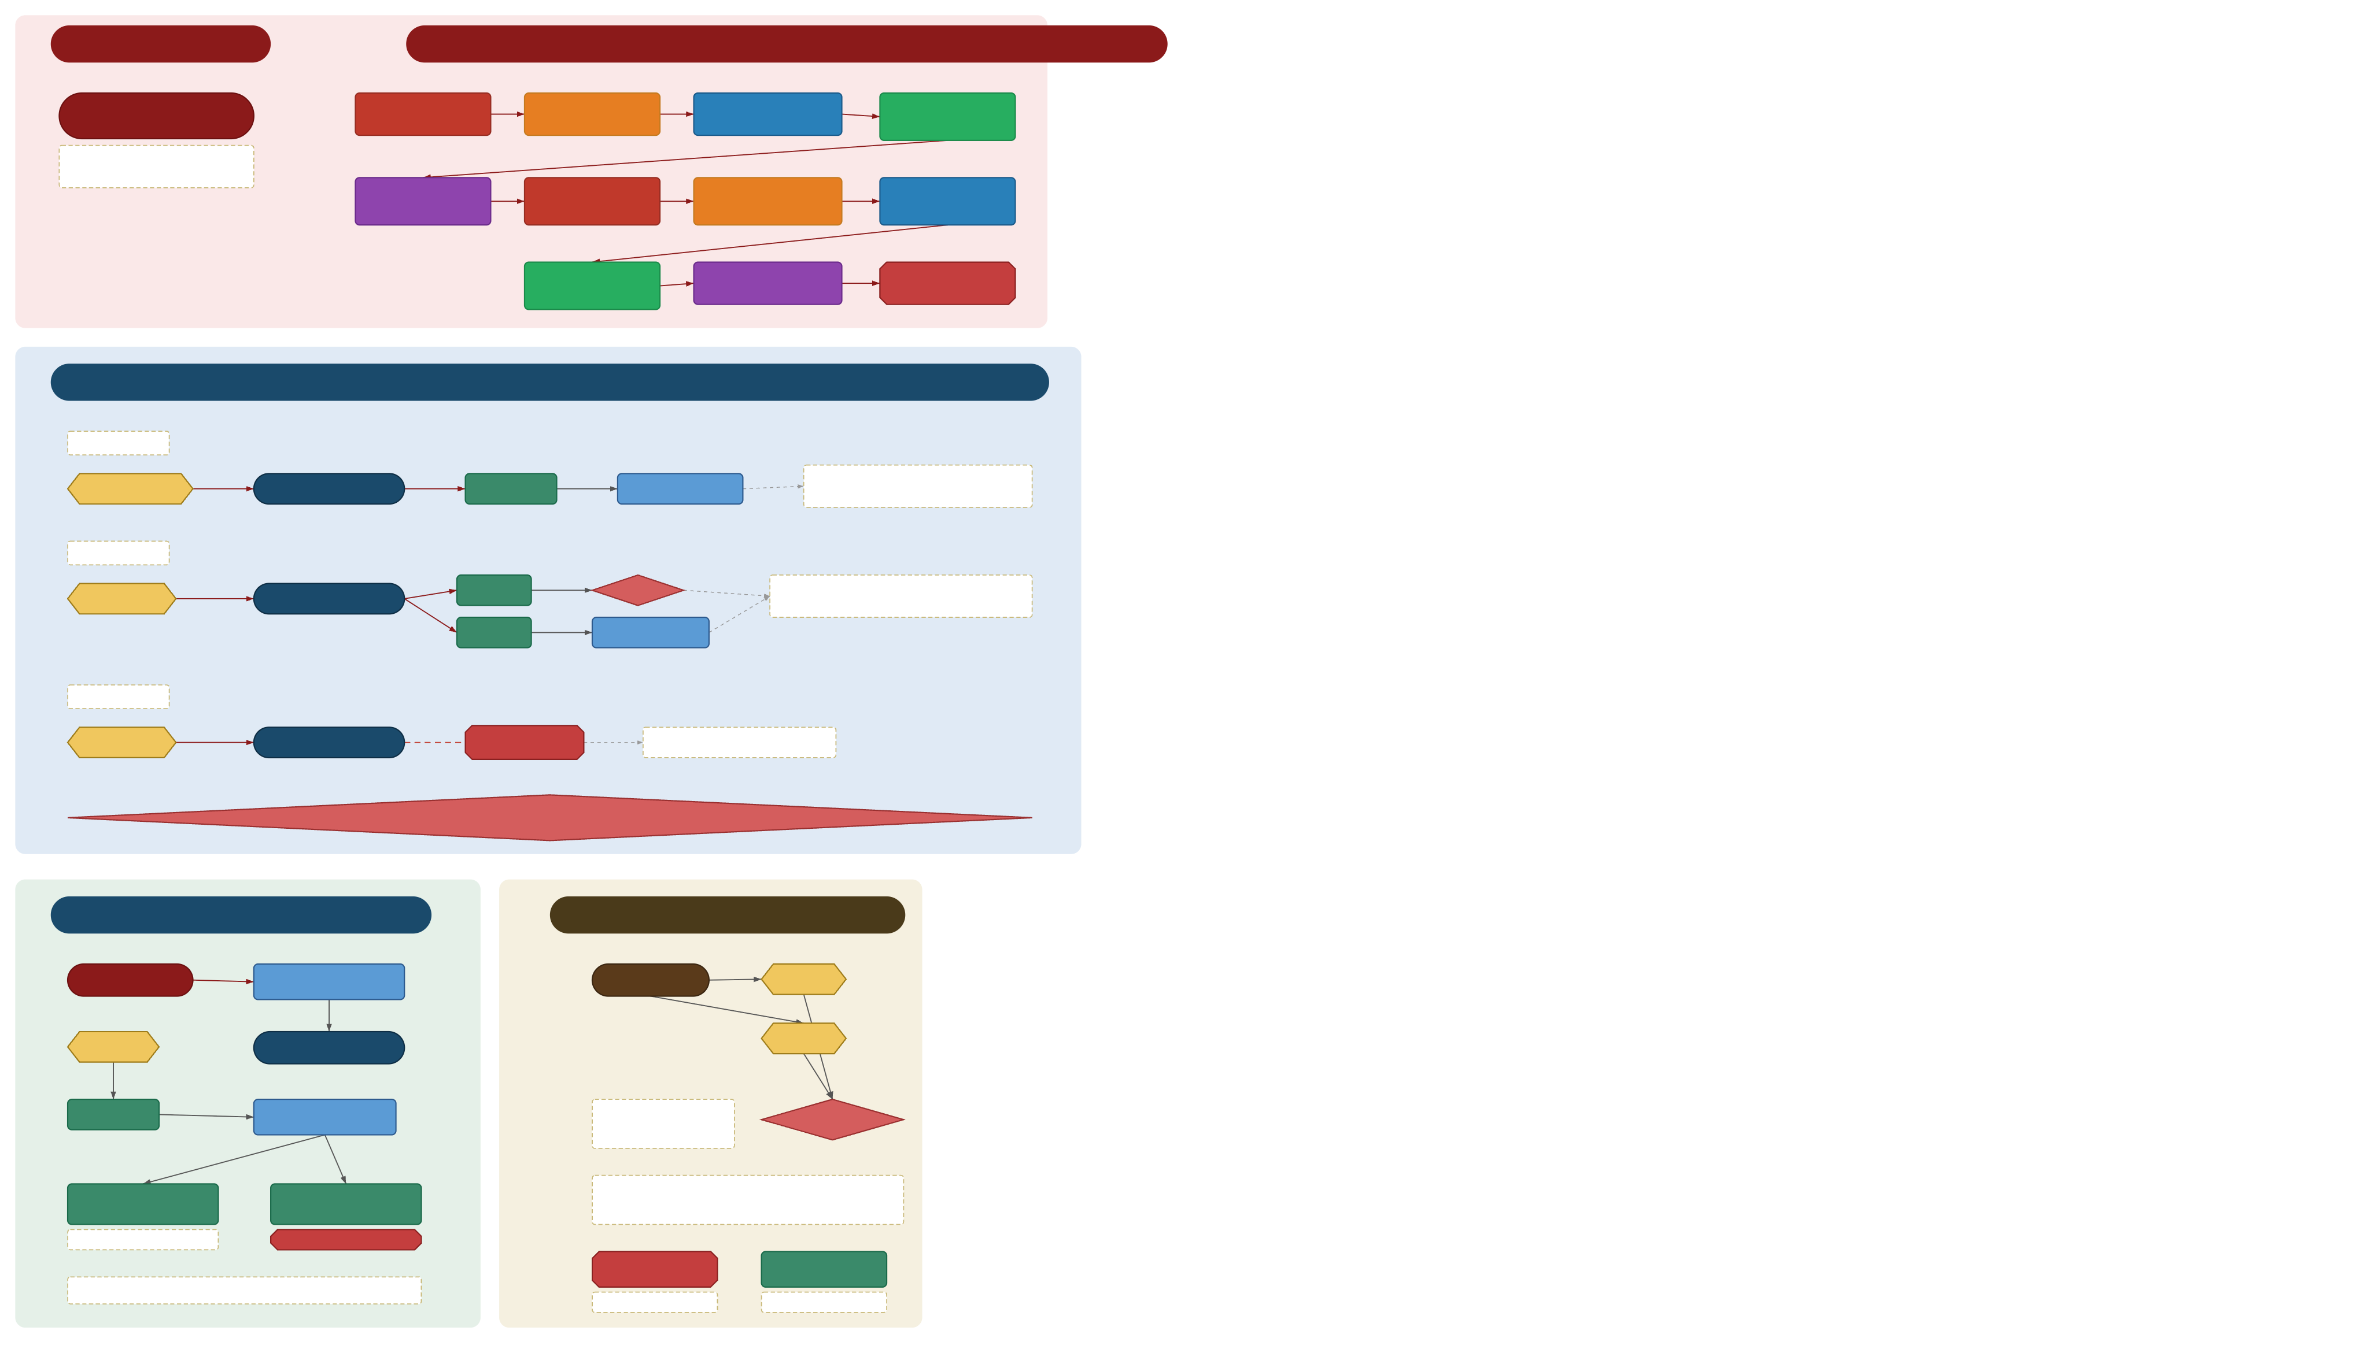
B/B · MCAT BIOCHEMISTRY
GPCR SIGNALING
GENERAL GPCR STEPS (11-step cascade)
GPCR G-Protein Coupled Receptor
① Ligand Binding to GPCR
② Conformational Change
③ G-Protein GDP → GTP exchange
④ Subunit Dissociation Gα-GTP + Gβγ
7-transmembrane receptor largest receptor family metabotropic (not ion channel)
⑤ Effector Activation (AC, PLC, etc.)
⑥ 2nd Messenger Production (cAMP, IP3, DAG)
⑦ Downstream Signaling Pathways
⑧ Cellular Response (gene expr, metab)
⑨ GTP Hydrolysis on Gα GTP → GDP
⑩ G-Protein Reassociation
⑪ Signal Termination
GPCR EFFECTOR PATHWAYS
Gαs pathway
Norepinephrine
Adenylate Cyclase
produces
cAMP
activates
Protein Kinase A
↑ protein phosphorylation glycogen breakdown · gene regulation
Gαq pathway
Glutamate
Phospholipase C
IP₃
Ca²⁺ release
↑ phosphorylation + Ca²⁺-binding activate calmodulin · smooth muscle
DAG
Protein Kinase C
Gαi pathway
Dopamine (D₂)
Adenylate Cyclase
Gαi blocks
INHIBITED
↓ cAMP → ↓ PKA activity
KEY: Gαs = stimulatory (↑cAMP) · Gαq = PLC pathway (IP₃+DAG) · Gαi = inhibitory (↓cAMP) All use GTP hydrolysis as molecular switch · Cholera toxin locks Gαs ON · Pertussis locks Gαi OFF
EPINEPHRINE SIGNALING (example)
SUBSTRATES + GTP HYDROLYSIS
Epinephrine
β-adrenergic receptor (GPCR)
Substrates
ATP
ATP
Adenylyl Cyclase
GTP
cAMP
PKA (Protein Kinase A)
GTP hydrolysis releases free energy ΔG° = −RT ln Keq Keq ≈ 1 × 10⁵
Hydrolyzed
Glycogen Phosphorylase
Glycogen Synthase
GTP acts as molecular switch: GTP-bound = ON (active) GDP-bound = OFF (inactive) GTPase activity = built-in timer
ACTIVATED → breaks down glycogen
INACTIVATED → no synthesis
GAP (GTPase-activating)
GEF (guanine exchange)
NET: Epi → ↑ blood glucose via glycogen breakdown
speeds GTP → GDP (OFF)
speeds GDP → GTP (ON)
LEGEND
⬭ receptor ▭ step ⬡ molecule ◆ key event ⬣ termination ┈┈ note All arrows: straight lines
Red = GPCR Steps Blue = Pathways Green = Epinephrine Gold = Substrates

Slide 3
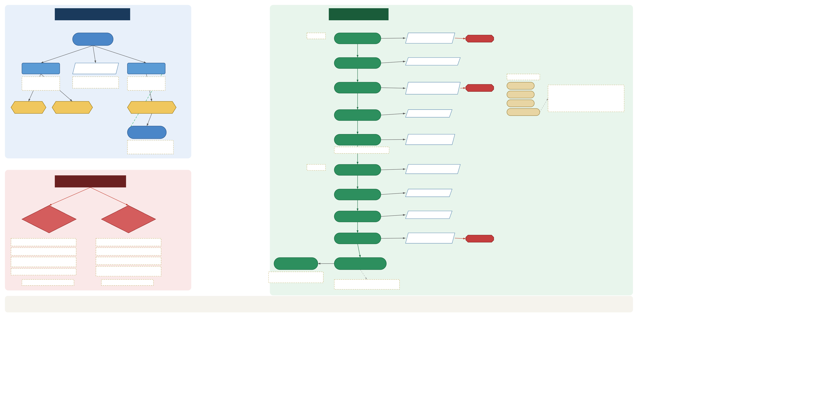
B/B · MCAT BIOCHEMISTRY
GLUCOSE TRANSPORT
GLYCOLYSIS
Glucose
INVESTMENT
Glucose
Hexokinase ATP → ADP
IRREVERSIBLE
GLUT-2
Glucokinase
GLUT-4
Glucose-6-P
Phosphoglucose isomerase
Low affinity · high Km Insulin-INDEPENDENT
Very high Km glucose sensor in pancreas
Insulin-DEPENDENT Km ≈ blood [glucose]
PFK-1 ★ rate-limiting ATP → ADP
PFK-1 Regulators
Fructose-6-P
IRREVERSIBLE
ATP ⊝
Bifunctional enzyme PFK-2 ↔ F-2,6-BPase ↑ insulin → PFK-2 → glycolysis ↑ glucagon → BPase → GNG
Citrate ⊝
Liver
β-cells (pancreas)
Adipose + Muscle
AMP ⊕
Fructose-1,6-BP
Aldolase
F-2,6-BP ⊕
Insulin
GAP (G3P)
GAPDH NAD⁺ + Pi → NADH
Peptide hormone RTK · Tyr kinase receptor inserts GLUT-4 into membrane
Aldolase splits → GAP + DHAP · ×2
PAYOFF
1,3-BPG
PG kinase → ATP (substrate-level)
DIABETES MELLITUS
3-PG
PG mutase
Type 1 DM autoimmune
Type 2 DM insulin resistance
2-PG
Enolase · −H₂O
β-cells destroyed → no insulin
Insulin insensitivity
PEP
Pyruvate kinase → ATP
IRREVERSIBLE
GLUT-4 works but cells starve
GLUT-4 won't respond
Crisis: DKA diabetic ketoacidosis
Treat w/ metformin (early)
Lactate
Pyruvate (×2)
Blood sugar 700–900
Crisis: HHS hyperosmolar hyperglycemic
Anaerobic → regenerates NAD⁺ no O₂ → ETC off → lactate
see → Insulin (Transport)
see → Insulin (Transport)
NET: +2 ATP +2 NADH +2 pyruvate
LEGEND
⬭ molecule ▭ concept ⬡ location ◆ disease ▱ enzyme ⬣ irreversible ┈┈ note
Blue = Transport Red = Diabetes Green = Glycolysis

Slide 4
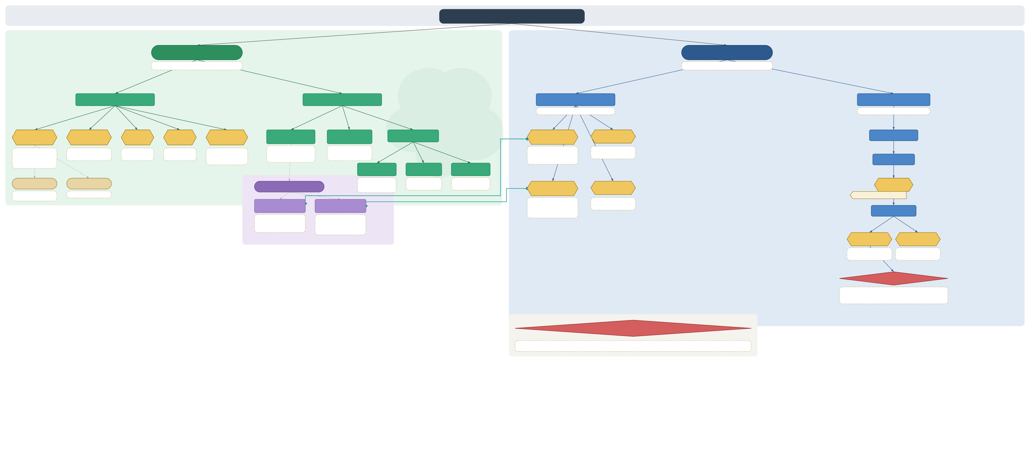












B/B · MCAT BIOLOGY
IMMUNE SYSTEM
INNATE IMMUNE SYSTEM
ADAPTIVE IMMUNE SYSTEM
Always active · non-specific · no memory
Specific · slower · has memory
NONCELLULAR DEFENSES
CELLS OF INNATE SYSTEM
CELL-MEDIATED
HUMORAL IMMUNITY
T-cell mediated
Antibody-mediated (B-cells)
Complement
Mucous Membranes
Skin
GI Tract
Interferons
Macrophages
Natural Killer Cells
Granulocytes
Cytotoxic T-Cells (CD8⁺)
Regulatory T-Cells
Antigen Exposure
Phagocytic
Kill infected/cancer cells
Recognize MHC-I
Suppress immune
•
Lysozymes in tears
Physical barrier
Stomach acid
engulf + display on MHC
•
Cytokines from infected cells prevent viral replication in neighboring cells
•
response · prevent
Plasma proteins
perforin + granzymes
•
•
on infected cells
release cytokines
•
•
autoimmunity
saliva · nasal secretions
•
acidic pH · sweat
•
low pH kills microbes
•
•
innate (no MHC needed)
enhance phagocytosis
•
•
perforin + granzymes
Lymphoblasts
•
antigen-presenting cell
lyse pathogens
•
•
displays
→ apoptosis
trigger inflammation
Neutrophils
Basophils
Eosinophils
Classical Pathway
Alternative Pathway
First responders
Inflammatory +
Anti-parasitic
Memory T-Cells
B-Cells
•
allergic response
•
•
allergic response
Helper T-Cells (CD4⁺)
MHC Complex
most abundant WBC
•
release histamine
•
•
granule release
Requires antibody
No antibody required
phagocytic
MHC-I presents → CD8⁺
Helper T · co-stim
•
bound to antigen
MHC-II presents → CD4⁺
Activated by MHC-II
Long-lived
•
MHC-I
MHC-II
•
rapid response on
on APCs
•
1. Co-stimulate B-cells
re-exposure
Clonal B-Cells
2. Activate macrophages
All nucleated cells
APCs only
3. Secrete cytokines
•
•
exogenous pathway
endogenous pathway
•
•
(antigens from OUTSIDE)
(antigens from INSIDE)
•
•
presents to CD4⁺
presents to CD8⁺
•
(helper T-cells)
Plasma Cells
Memory B-Cells
Secrete antibodies
Long-lived
•
effector cells
•
•
faster response on
short-lived
•
secrete
re-exposure
ANTIBODIES (Immunoglobulins)
•
IgG (most abundant · crosses placenta)
•
IgM (first responder · pentamer)
•
IgA (mucous membranes · secretory)
•
IgE (allergies · parasites) · IgD (B-cell receptor)
KEY: Innate = fast · non-specific · no memory Adaptive = slow · specific · HAS memory Humoral = B-cells + antibodies (extracellular) Cell-mediated = T-cells (intracellular pathogens)
MHC-I + CD8⁺ = cytotoxic (kill infected cells) MHC-II + CD4⁺ = helper (coordinate response)
LEGEND
⬭ system ▭ cell type ⬡ specific cell ◆ key concept ⬭ purple = MHC ┈┈ note/cross-ref
──▶ green = innate ──▶ blue = adaptive ◆──◆ teal = MHC↔T-cell cooperation ▷ gold chip = cross-reference underline = high-yield

Slide 5
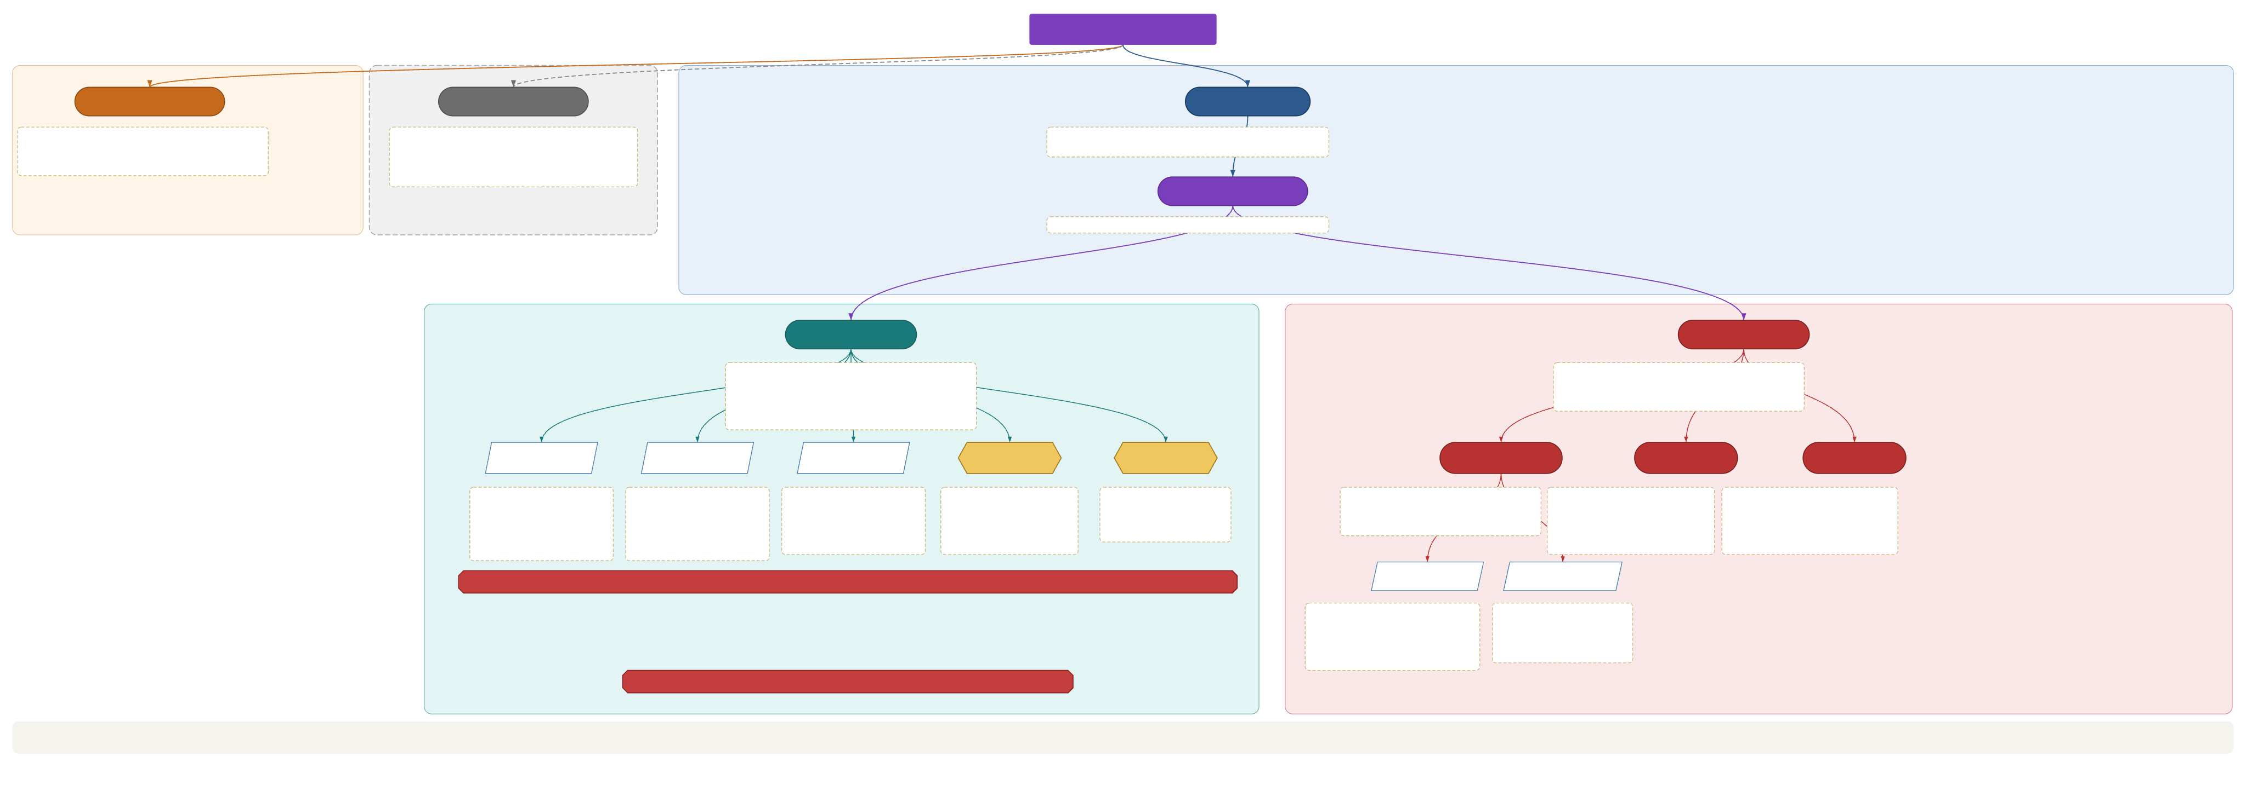
C/P · MCAT CHEMISTRY
ISOMERS
Constitutional / Structural
Conformational Conformers
Stereo Isomers
Same molecular formula, different connectivity Types: Chain · Positional · Functional Group e.g. n-butane vs isobutane (chain isomers)
Same molecule · bond rotation only Interconvert freely · no bond breaking required Newman projections: staggered · eclipsed · gauche · anti Ring conformers: chair · boat · twist-boat
Same formula, same connectivity, different spatial arrangement Require bond breaking (or reflection) to interconvert
Configurational Isomers
Require bond breaking to change configuration; includes optical AND geometric isomers
Enantiomers
Diastereomers
Non-superimposable mirror images Opposite R/S at EVERY chiral center Same physical properties (bp, mp, solubility, density) Opposite optical rotation direction (+/−)
NOT mirror images Opposite R/S at ONLY SOME chiral centers Different physical properties — can be separated!
R / S Absolute Config.
D / L Relative Config.
(+) / (−) Optical Rotation
Meso Compound
Racemic Mixture
Geometric Isomers
Epimers
Anomers
CIP Priority Rules sp³ C with 4 different groups = chiral center Rank substituents 1→4 (highest atomic # = 1) R = clockwise (rectus) S = counterclockwise (sinister)
Fischer Convention D = OH on right at reference carbon L = OH on left at reference carbon Most natural sugars: D-form Most natural amino acids: L-form
Measured by polarimetry (+) dextrorotatory = CW rotation of light (−) levorotatory = CCW rotation NOT correlated with R/S or D/L!
Has chiral centers, BUT achiral overall Internal plane of symmetry Optical rotation = 0 (inactive) e.g. meso-tartaric acid
50:50 mix of enantiomers Net optical rotation = 0 Cannot separate by standard physical methods (need chiral column or resolving agent)
Restricted rotation (C=C double bond or ring) Cannot interconvert without breaking π bond E/Z = preferred IUPAC; cis/trans = H-based (older)
Differ at ONLY ONE chiral center (always diastereomers) D-Glucose vs D-Galactose → C4 epimers D-Glucose vs D-Mannose → C2 epimers
Epimers at the anomeric carbon (C1) Formed during ring closure of open-chain sugars α = OH axial (below ring plane) β = OH equatorial (above ring plane) Interconvert in solution via mutarotation
R/S · D/L · (+)/(−) are INDEPENDENT — each must be determined separately!
E / Z (CIP-based)
cis / trans (H-based)
E (Entgegen) = higher priority groups on OPPOSITE sides of double bond Z (Zusammen) = higher priority groups on the SAME side of double bond Assign using CIP rules (same as R/S)
cis = same groups on same side trans = same groups on opposite side Only reliable for H-bearing carbons Use E/Z when no H on double bond carbon
Max stereoisomers = 2ⁿ (n = # chiral centers); fewer if meso compound(s) exist
LEGEND
▱ notation / designation ⬡ special case ○ concept node ⬣ key exam rule ┄┄ conformers (not true isomers)
Purple = Configurational hierarchy Teal = Enantiomers section Red = Diastereomers section Orange = Constitutional Gray dashed = Conformational

Slide 6
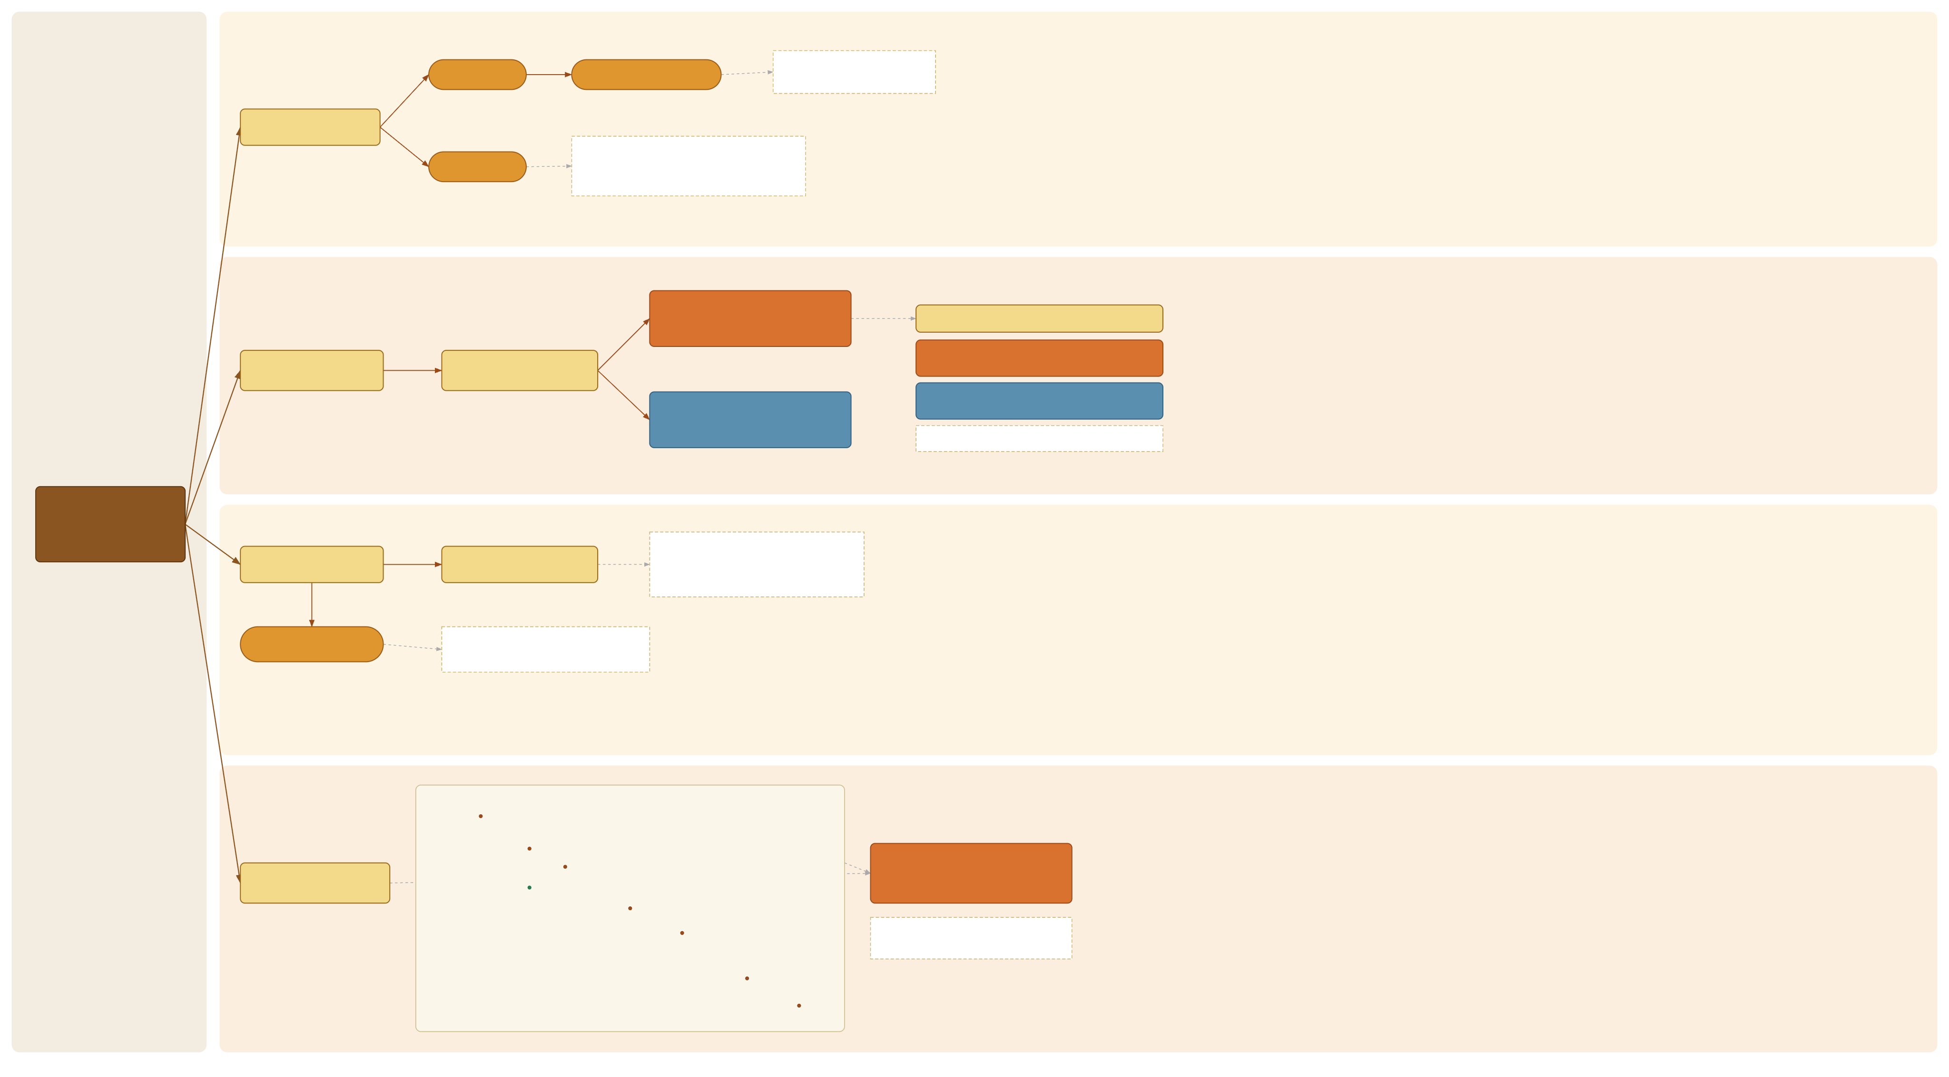
B/B · MCAT BIOCHEMISTRY
REACTANTS & PRODUCTS
Reactants
Aerobic vs Anaerobic
Anaerobic respiration (glycolysis / fermentation) occurs in the cytosol
Reactants & Products
At the start of glycolysis, ↑ [reactant] shifts the reaction spontaneously toward products (Le Châtelier’s principle)
Products
REDOX & ENERGY COUPLING
CATABOLISM — oxidative breakdown uses NAD⁺ & FAD → NADH, FADH₂ releases energy (exergonic)
METABOLISM OVERVIEW
Reduction is coupled to an oxidation
Couples spontaneous + nonspontaneous reactions
Catabolism: energy nutrients (carbs, lipids, proteins) → CO₂, H₂O, NH₃ + ATP
ANABOLISM — reductive biosynthesis uses NADPH · requires energy ↓ entropy (builds order)
Anabolism: precursors (amino acids, sugars, fatty acids) → macromolecules
shared currency: ADP+Pi, NAD⁺ ⇌ ATP, NADH
GENERAL RULES OF METABOLISM
REGULATION
Many irreversible steps
controlled by
Highly regulated, irreversible enzymes
Most key enzymes are regulated by hormones AND by their own product (feedback inhibition) acting at the allosteric site
LEGEND
Spontaneous = large negative ΔG
Example: glycolysis irreversible steps 1, 3, 10 → hexokinase, PFK-1, pyruvate kinase
▭ concept / rule
⬭ key term
▭ catabolic (orange)
▭ anabolic (blue)
┌┄┐ note / detail
Reorganized from source map;
facts per Kaplan / UWorld / Jack Westin
THERMODYNAMICS & THE ELECTRON TRANSPORT CHAIN
High
NAD⁺ / NADH
Complex I
Complex IV has the highest reduction potential (E°′ = +) O₂ = final electron acceptor
Thermodynamics (gen chem / orgo)
H⁺ pumped
Q
FADH₂ / Complex II
Complex III
H⁺ pumped
cyt c
Large drops in free energy drive H⁺ pumping at Complexes I, III, IV
Free energy (G)
large free-energy drops
Complex IV
Low
drive H⁺ pumping
H⁺ pumped
Electron Transport Chain ⟶
O₂

Slide 7
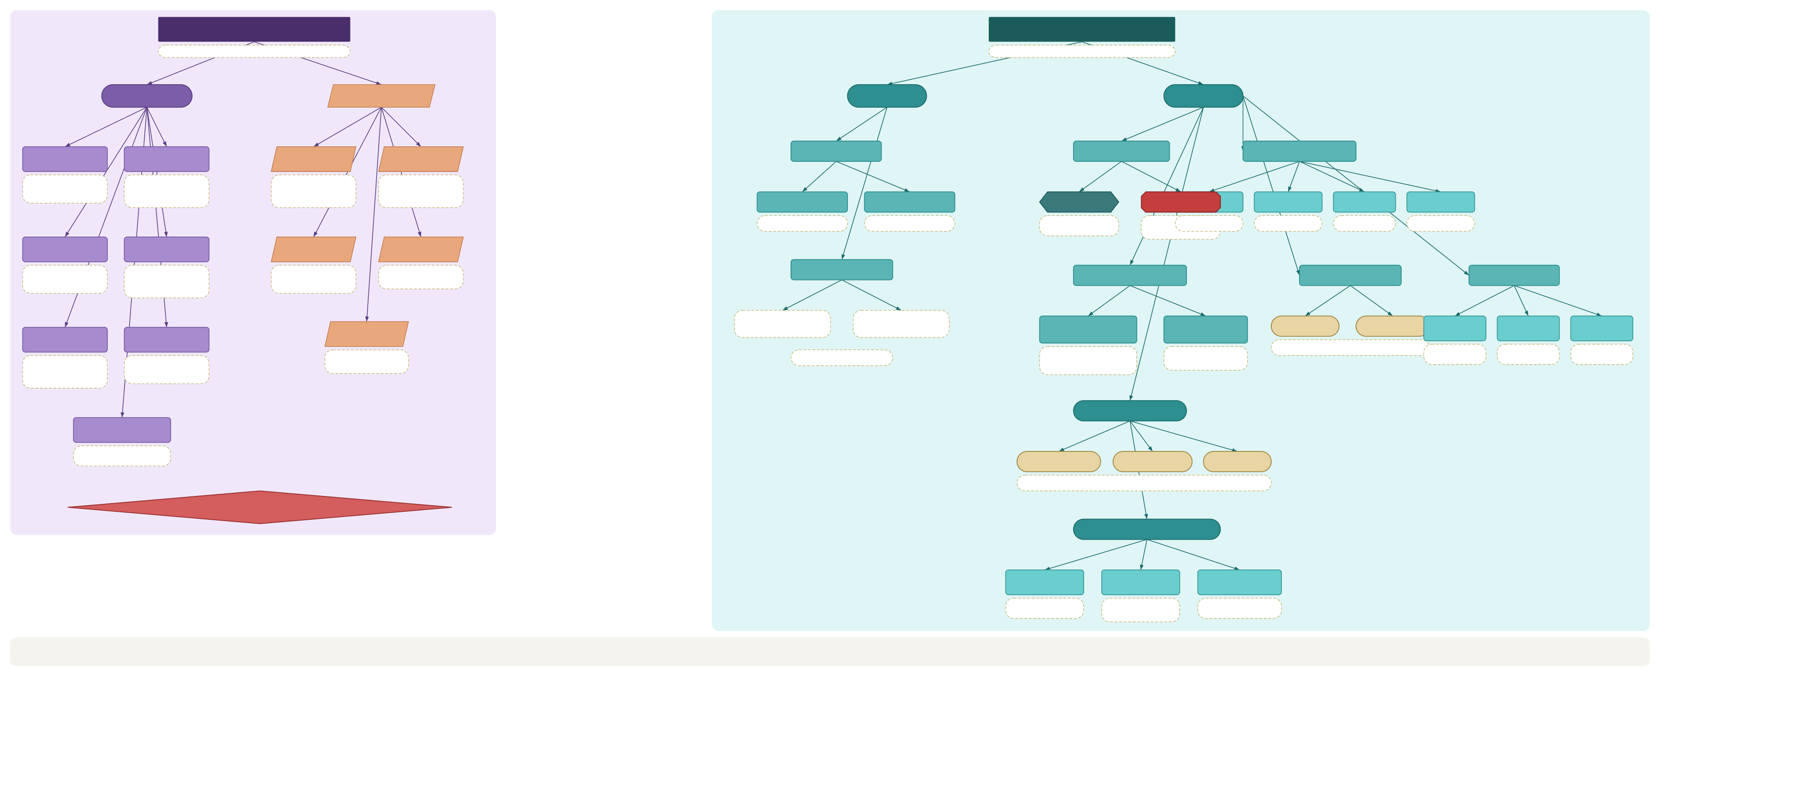
B/B · MCAT BIOCHEMISTRY
PROTEIN MODIFICATION
PLASMA MEMBRANE
post-translational modifications (PTMs)
fluid mosaic model
Enzymatic
Non-Enzymatic
« Fluid »
« Mosaic »
Phosphorylation
Glycosylation
Glycation
Disulfide Bond
Movement
Semipermeable
Selective Transport
Kinase ↔ Phosphatase PO₄ on Ser/Thr/Tyr on/off switch · signaling
Glycosyltransferases sugar on Asn (N) or Ser/Thr (O) folding · recognition tag
spontaneous sugar on Lys NOT enzyme-driven HbA1c = glucose marker linked to aging
two Cys → S–S bond spontaneous oxidation stabilizes 3D structure
Lateral Diffusion
ATP-Driven Flip
Passes Freely
Needs Help
Channels
Carriers
Pumps
Receptors
unrestricted · spontaneous
moves lipid btwn leaflets
uncharged · small nonpolar (O₂, CO₂)
charged · large polar · ions glucose · H₂O
Na⁺/K⁺ · aquaporins
transporters
Na⁺/K⁺ ATPase
GPCRs
Lipidation
Ubiquitination
Deamination
Oxidation
prenyl/palmitoyl/GPI anchors protein to membrane
E1-E2-E3 ligase cascade ubiquitin tag on Lys flags for proteasome → breakdown
Asn→Asp · Gln→Glu spontaneous hydrolysis alters folding · aging
ROS modifies Met/Cys side chain damage linked to aging
Fluidity Regulation
Membrane Proteins
Membrane Carbs
CAMs
Temp ↑ → more fluid adapt: ↑ saturated FAs + cholesterol
Temp ↓ → more rigid adapt: ↑ unsaturated FAs kinks prevent packing
Integral / Transmembrane
Peripheral
Glycolipid
Glycoprotein
Cadherin
Integrin
Selectin
Acetylation
Methylation
Isomerization
α-helix or β-barrel embedded · hydrophobic permanent anchoring
associated surfaces loosely attached removable
exterior face only → cell recognition
Ca²⁺ dependent cell-cell cohesion
α,β subunits binds ECM
binds carbs immunity
Acetyltransferase acetyl-CoA on Lys neutralizes + charge histones → epigenetics
Methyltransferase (SAM) methyl on Lys/Arg activate/repress genes
L→D or cis/trans Pro spontaneous alters folding kinetics
Cholesterol = fluidity buffer
Proteolytic Cleavage
Phospholipid Bilayer
removes peptide segments zymogen → active enzyme
Glycerophospholipid
Sphingomyelin
Cholesterol
KEY DISTINCTION Enzymatic: specific · regulated · reversible → signaling Non-enzymatic: spontaneous · irreversible · accumulates → damage/aging
glycerol-based · sphingosine-based · sterol (no FA tails)
Cytoskeleton (anchors membrane)
Microfilaments
Microtubules
Intermediate Filaments
Actin · thin filaments contractile ring
Tubulin (α/β) centrosome · spindle flagella
Keratin · desmin tensile strength
LEGEND
⬭ category ▭ concept ▱ modification ⬡ location ◆ key distinction ⬣ warning ┈┈ note
Purple = Protein Modification Teal = Plasma Membrane

Slide 8

Multiplication (×)
C/P · MCAT PHYSICS · UNITS & VARIABLES
Base Units (SI)
Derived Units
Division (÷)
Time (t)
Distance (d, x)
Mass (m)
Charge (Q, q)
second
meter
kilogram
coulomb
s
m
kg
C
k
= 8.99×10⁹
N·m²/C²
Coulomb constant
k = 1/(4πε₀)
kg·m/s
m/s
= N·s
N/C
Amp
ε₀
N·s
= V/m
(A)
Momentum (p)
= kg·m/s
= C/s
= 8.85×10⁻¹²
Velocity (v)
p = mv
C²/N·m²
v = d / t
Electric Field (E)
Current (I)
Impulse (J)
E = F/q = kq/r²
I = Q / t
Permittivity
J = FΔt = Δp
of free space
Newton
E = V / d
m/s²
(N)
= kg·m/s²
Acceleration (a)
Force (F)
Volt
Ohm
a = Δv / t
F = ma · F = qE
(V)
(Ω)
= J/C
= V/A
Joule
Potential / Voltage (V)
Resistance (R)
Watt
(J)
V = U/q = kq/r
V = IR
(W)
= N·m
= J/s
Work / Energy (W, KE, PE)
Farad
Power (P)
W = Fd · U = qV
(F)
P = W/t = IV
= C/V
Capacitance (C)
C = Q / V
Don't confuse the UNIT with the VARIABLE
"What other unit is this equal to?" — forms they sneak in
C — the unit is Coulombs (measures charge, variable Q); the variable C is capacitance, whose unit is the farad (F).
kg·m/s² = N
N·m = J
N·s = kg·m/s
J/s = W
W — the unit is the Watt (measures power); the variable W is Work, measured in joules (J).
F = ma
W = Fd
J = Δp
P = W/t
V — the unit is the Volt; the variable V is voltage (and, in chem, volume in liters).
atm·L = J
N/m² = Pa
C·V = J
C·V/m = N
Same letter, different roles — always read whether they mean the unit or the quantity.
W = −PΔV
P = F/A
U = qV
F = qE
F·V = C
A·Ω = V
C/s = A
W/A = V
Q = CV
V = IR
I = Q/t
P = IV

